Slide 1
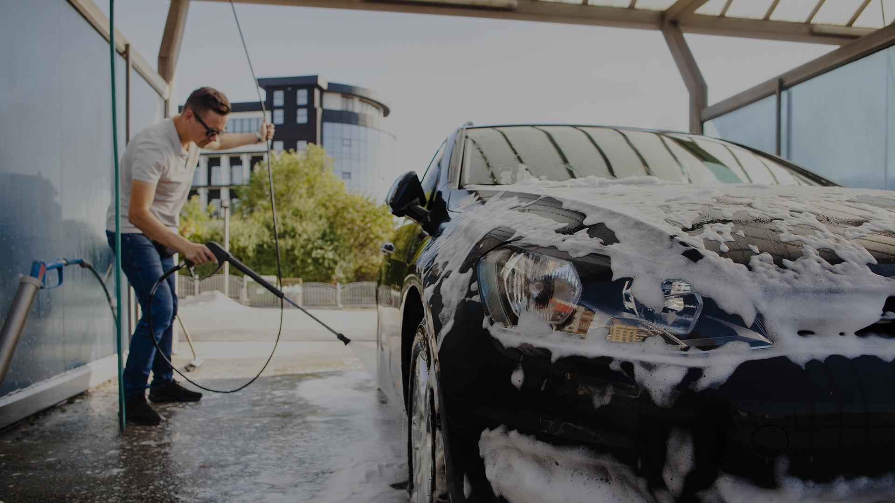
CAR Parking System
By Elites & Ambassador

Slide 2



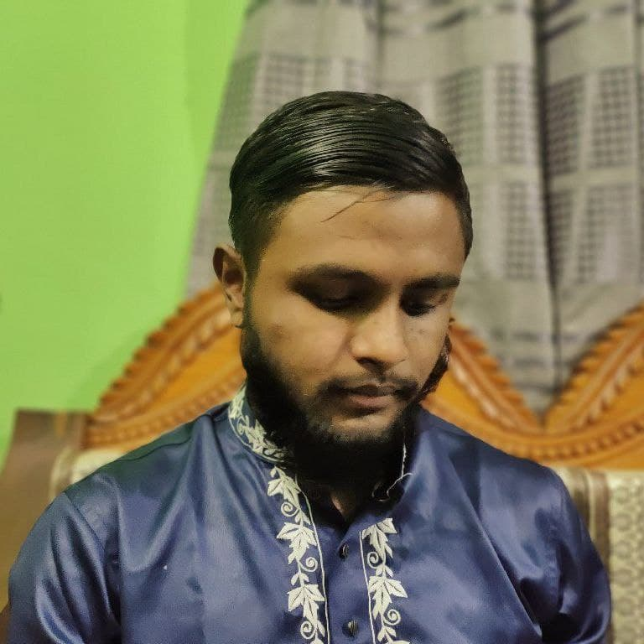
Elites & Ambassador
AZMARY
JAHID
FAHIM
NAZMUL
193902019
193902001
193902022
193902031

Slide 3
TABLE OF CONTENTS
01
02
03
P R O J CT O V ER V I E W
F E A T U R E S
F U T U R E SCOPE
Here you could describe the topic of the section
Here you could describe the topic of the section
Here you could describe the topic of the section

Slide 4
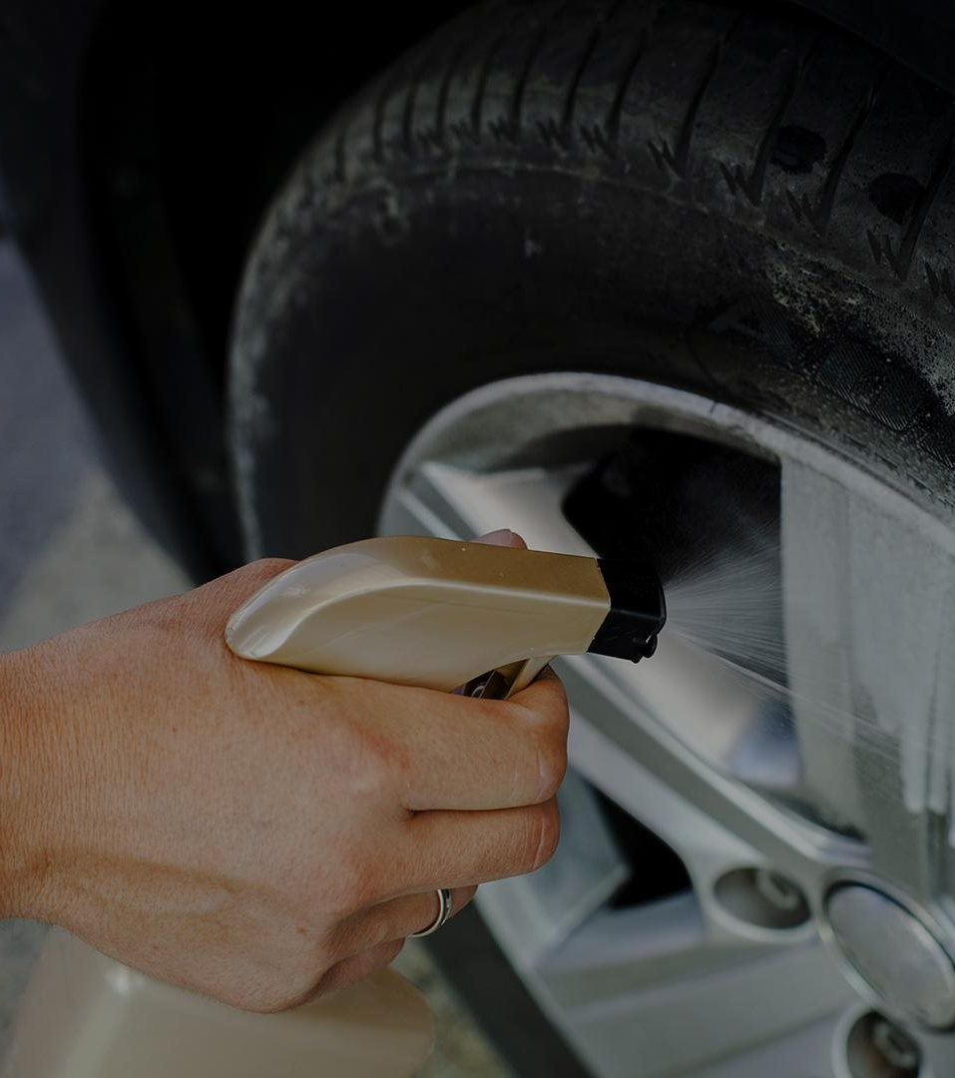
01
PROJCT OVERVIEW

Slide 5
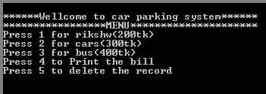
OUR SERVICES
CAR PARKING SYSTEM

Slide 6
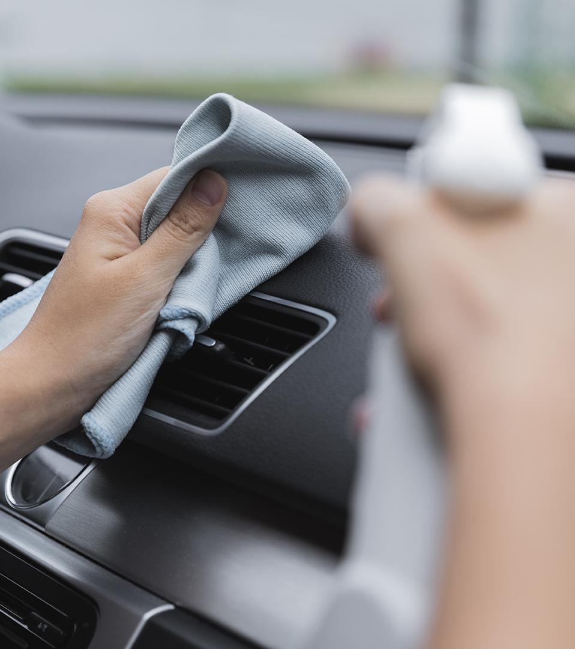
02
F E A T U R E S
MEJOR ENTITY OF OUR PROJECT

Slide 7
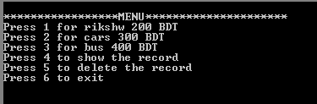
P R O J E C T Function
Loop
while_:
;Menu
mov dx,10
mov ah,2
int 21h
mov dx,13
mov ah,2
int 21h

Slide 8

P R O J E C T Function
offset
mov dx,offset menu
mov ah,9
int 21h

Slide 9
P R O J E C T Function
New line
mov dx,10
mov ah,2
int 21h
mov dx,13
mov ah,2
int 21h

Slide 10
P R O J E C T Function
Compare jump and input
mov al,bl
cmp al,'1'
je rikshw
cmp al,'2'
je car
cmp al,'3'
je bus
cmp al,'4'
je rec
cmp al,'5'
je del
cmp al,'6'
je end_
car:
call caar
rec:
call recrd
del:
call delt
bus:
call buss
mov ah,1
int 21h
mov bl,al
mov dx,10
mov ah,2
int 21h
mov dx,13
mov ah,2
int 21h

Slide 11
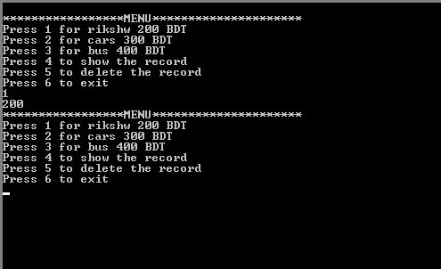
P R O J E C T F E A T U R E S
PARKING MENU & COST

Slide 12
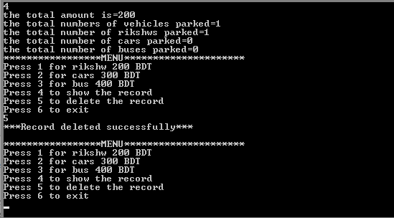
P R O J E C T F E A T U R E S
DELETE THE RECORDS

Slide 13
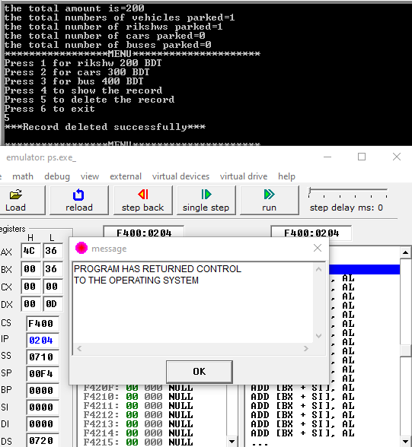
P R O J E C T F E A T U R E S
Exit

Slide 14
03
F U T U R E SCOPE

Slide 15
03
Benefits of car Parking

Slide 16
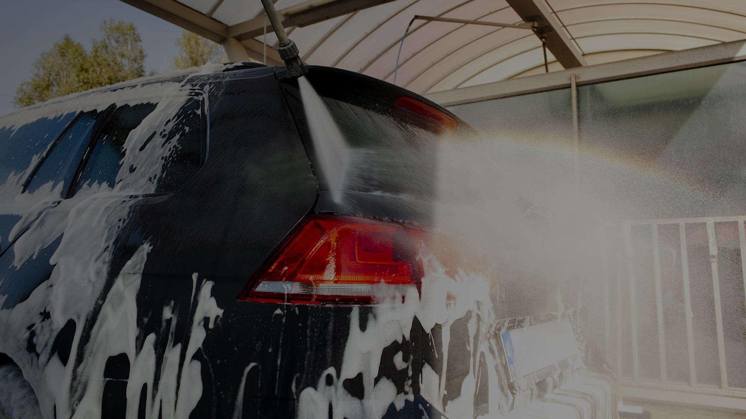
THANKS!
Do you have any questions?

